Slide 1
Chapter 6 Dynamic programming
School of Science, Yanshan University
Wang Gang

Slide 2
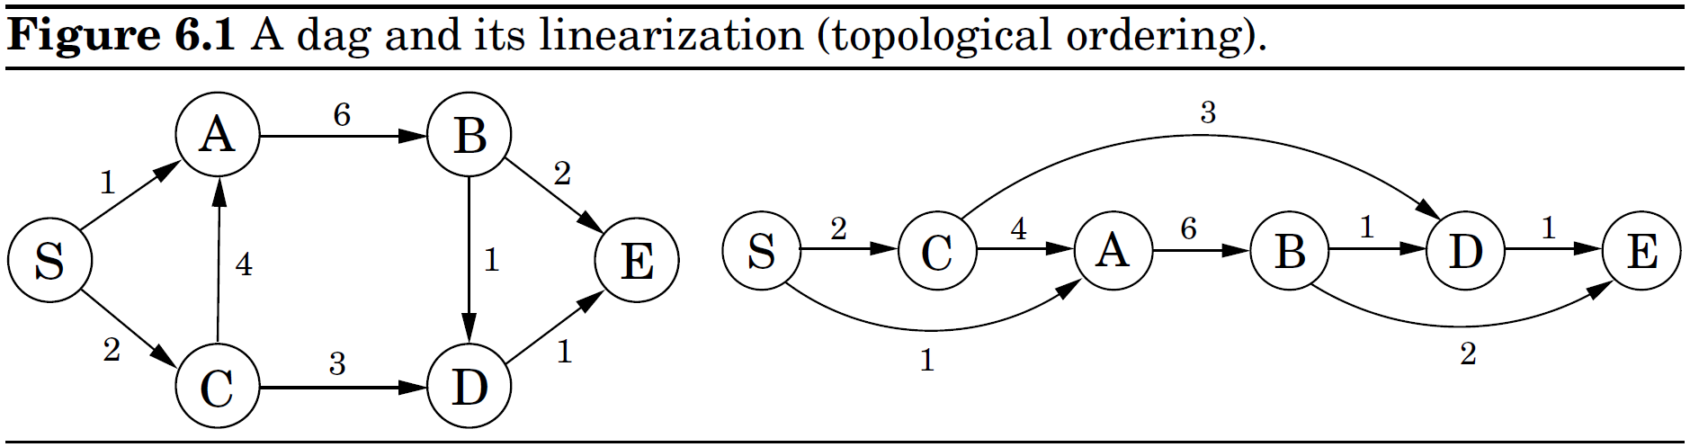
shortest paths in dags
An O(n) algorithm
initialize all dist(·) values to
dist(s) = 0
for each , in linearized order
DP (LP) is a technique invoked when more specialized methods fail.
An implicit dag of subproblems
using the answers to small subproblems to help figure out larger ones
tackling them one by one, smallest first, to fill out a table of solution values
DP's complexity = number of subproblems  complexity of subproblems
Notes:
DAG的拓扑排序：DFS，各点按照post值排序即可。

Slide 3
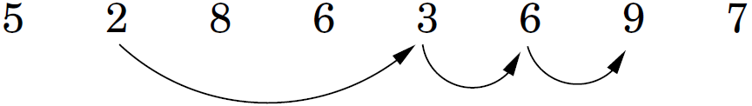
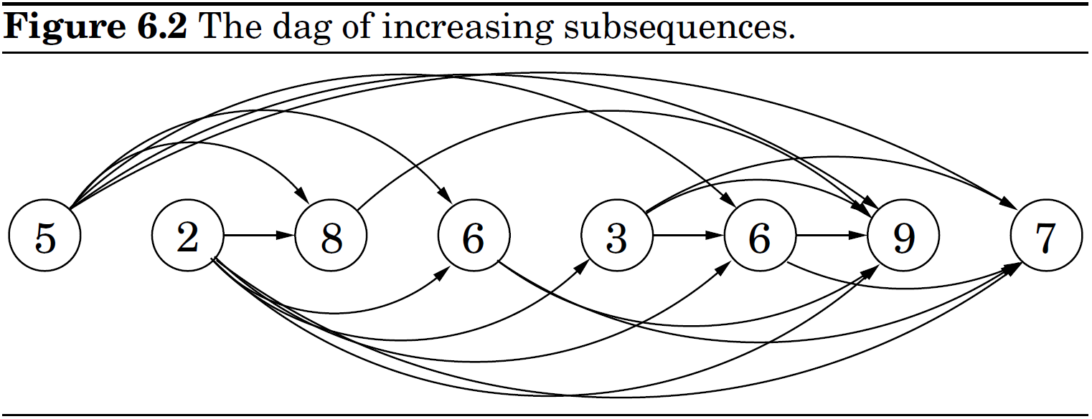
Longest increasing subsequences
Problem:
The longest increasing subsequences = the longest paths in dags
L(j): the length of the longest path ending at j
for j = 1, 2, ..., n
L(j)=1+max{L(i): (i, j)∈E)}
return max_{j}L(j)
Time complexity: O(m)

Slide 4
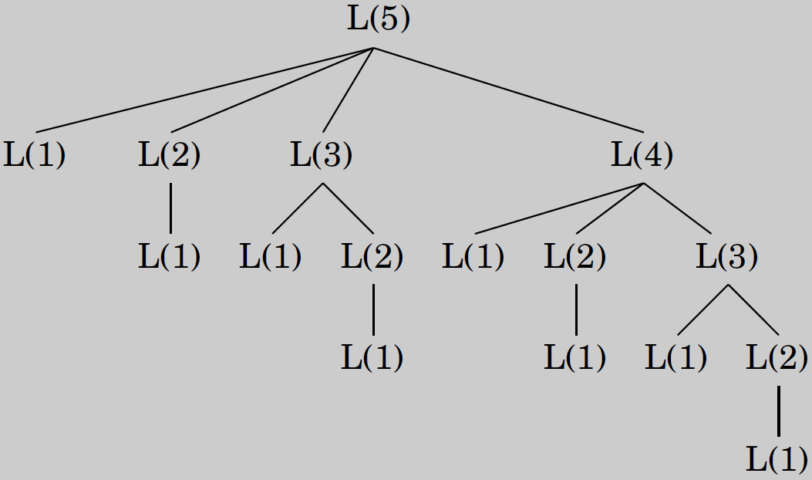
DP pk Recursion
Let L(j) = 1 + max{L(1), L(2), …, L(j-1)}. It also suggests a recursive algorithm. But the same subproblems get solved over and over again!
Recursion in divide-and-conquer: substantially smaller subproblems; the recursion tree has logarithmic depth and a polynomial number of nodes.
DP: subproblems are only slightly smaller; the recursion tree generally has polynomial depth and an exponential number of nodes; most of these nodes are repeats; efficiency is obtained by explicitly enumerating the distinct subproblems and solving them in the right order.

Slide 5
Edit distance
Edit distance:
(1) the min number of edits ― insertions, deletions, and substitutions of
characters ― needed to transform a first string into the second.
(2) the cost of a best possible alignment.
E[i, j]: the minimum edit distance between x[1…i] and y[1…j]
The rightmost column of a best alignment can be one of three things:

Slide 6
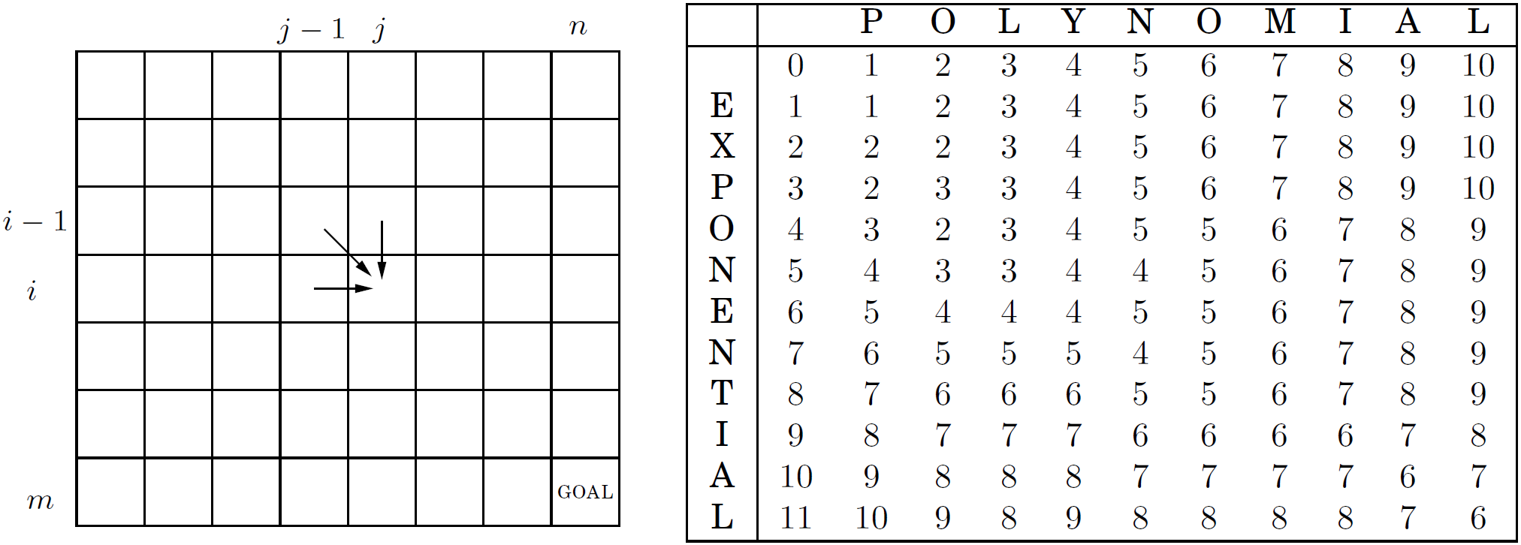
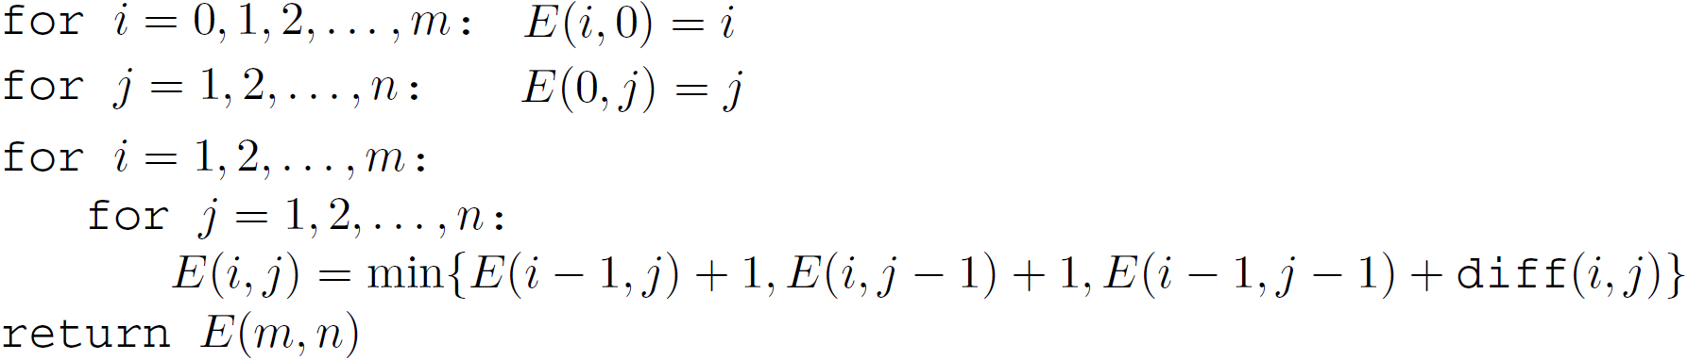
Edit distance
The answers to all the subproblems E(i, j) form a two-dimensional table. Any feasible order to solve these subproblems is fine.
An O(mn) DP algorithm

Slide 7
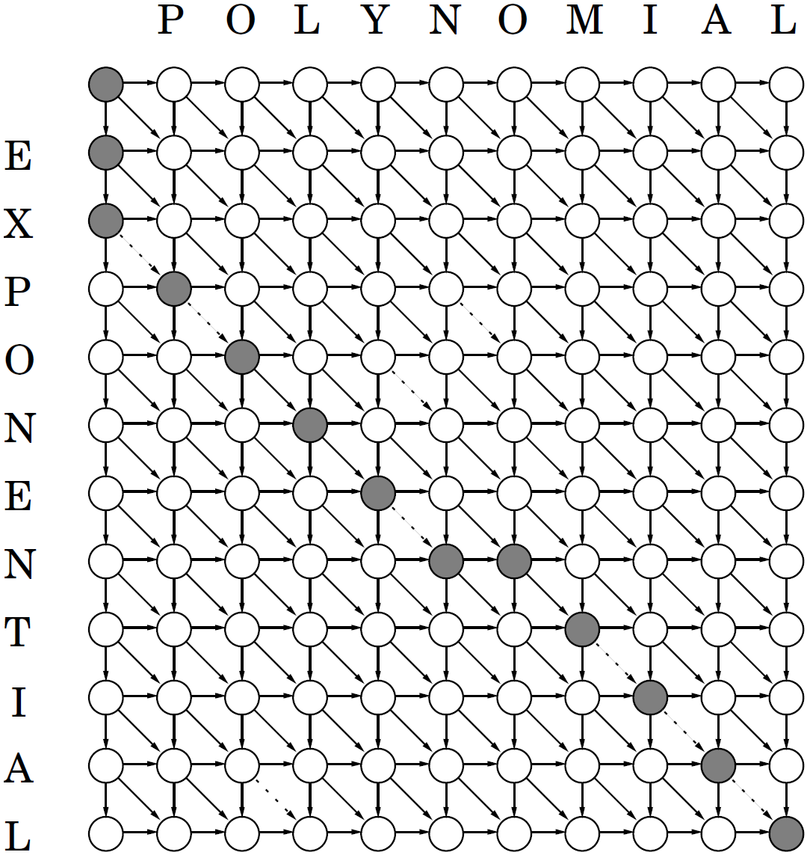
Edit distance
The underlying dag: from min edit distance to a shortest path in the dag
n
node: subproblem E(i, j).
edge: precedence constraint
edge length:
solid line, diff = 1
dotted line, diff = 0

Slide 8
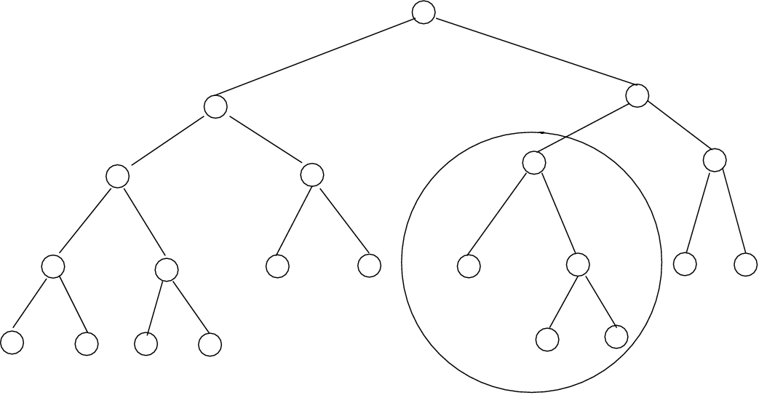
Subproblems in DP
Finding the right subproblem takes creativity and experimentation.
Some standard choices that seem to arise repeatedly in DP:
1. The input is x₁, x₂, …, x_{n}. A subproblem is x₁, x₂, …, x_{i}. O(n) subproblems.
2. The input is x₁, x₂, …, x_{n} and y₁, y₂, …, y_{m}. A subproblem is x₁, x₂, …, x_{i} and
y₁, y₂, …, y_{j}. O(nm) subproblems.
3. The input is x₁, x₂, …, x_{n}. A subproblem is x_{i}, …, x_{j}. O(n²) subproblems.
4. The input is a rooted tree. A subproblem is a rooted subtree.

Slide 9
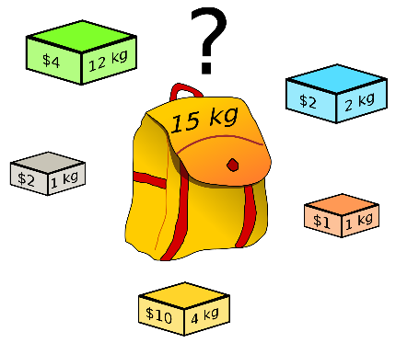
Knapsack
Knapsack: n items of weights w₁, …, w_{n}, values v₁, …, v_{n}. Find the most valuable combination of items that can be fit into a bag of capacity W?
Two versions: one or unlimited quantities of each item
Both versions
Unbounded knapsack: subproblems calls for smaller capacities.
One item i has already been in the knapsack
K(w) = maximum value achievable with a knapsack of capacity w
K(0) = 0
for w = 1 to W:
K(w) = max{K(w-w_{i}) + v_{i}: w_{i}≤w}
return K(W)
Fill in a one-dimensional table of length W+1 in left-to-right order. Each entry can take up to O(n) time to compute. The overall running time is O(nW).
Find the longest path in an implicit dag!

Slide 10
Knapsack
0-1 knapsack: Knowing the value K(w-w_{n}) doesn't help us, for we don't know whether or not item n already got used up in this partial solution. We refine our concept of a subproblem to carry additional information about the items being used.
K(w, j) = max value achievable using a knapsack of capacity w and
items 1,…, j.
Initialize all K(0, j)=0 and all K(w, 0)=0
for j = 1 to n
for w = 1 to W
if w_{j}>w K(w, j) = K(w, j-1)
else K(w, j) = max{K(w, j-1), K(w-w_{j}, j-1)+v_{j}}
return K(W, n)
Fill in a two-dimensional table, with W+1 rows and n+1 columns. Each table entry takes O(1) time. The running time remains O(nW).

Slide 11
Memoization
In DP, a recursive formula expresses large problems in terms of smaller ones and is then used to fill out a table of solution values in a bottom-up manner. The formula also suggests a recursive algorithm. But naive recursion can be terribly inefficient. A trick called memorization is of help.
A hash table, initially empty, holds values of K(w) indexed by w
function knapsack(w)
if w is in hash table return K(w)
K(w) = max{knapsack(w-w_{i}) + v_{i}: w_{i} ≤ w}
insert K(w) into hash table, with key w
return K(w)
Complexity: O(nW). Larger constant factor in this big-O notation.
In some cases, memoization pays off.
DP automatically solves every subproblem may be needed,
memorization only ends up solving the ones that are actually used.

Slide 12
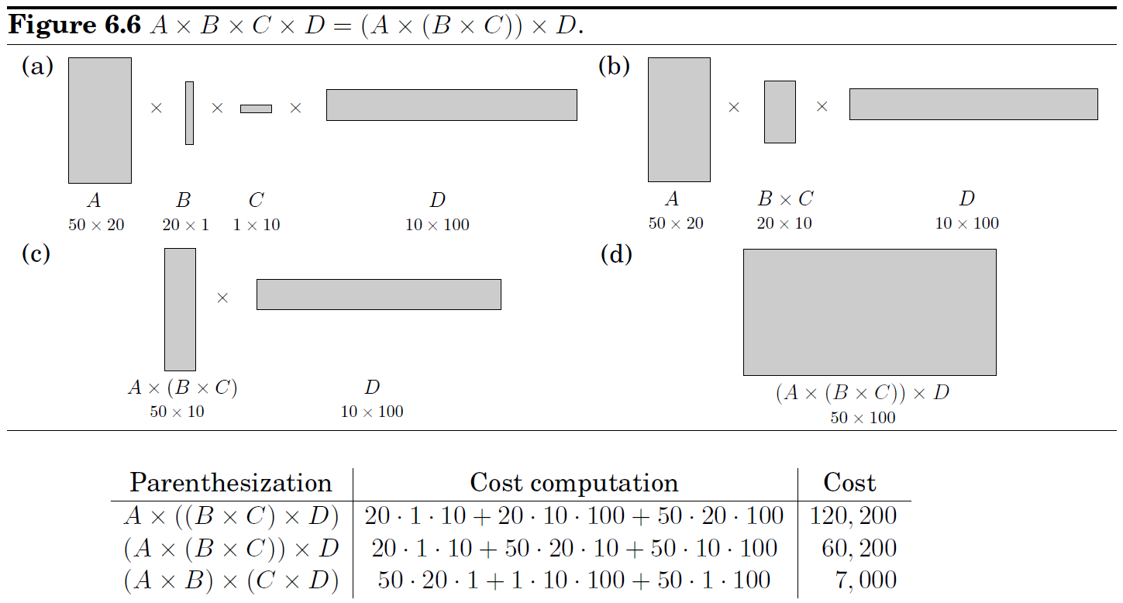
Chain matrix multiplication
Problem:

Slide 13
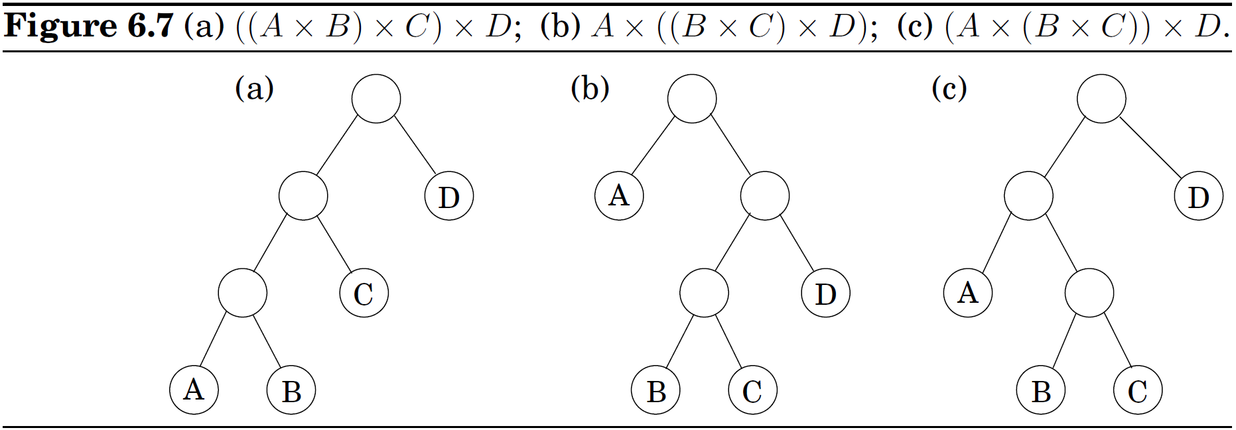
Chain matrix multiplication
The possible parenthesizations correspond to the various full binary trees with n leaves, whose number is exponential in n.
Subtrees of an optimal tree must also be optimal. Subtrees correspond to products of the form . Define
C(i, j) = minimum cost of multiplying .

Slide 14
Chain matrix multiplication
Subproblem: C(i, j) = minimum cost of multiplying .
=
The DP algorithm:
Complexity: The subproblems constitute a two-dimensional table, each of whose entries takes O(n) time to compute. The overall running time is O(n³).
for i = 1 to n
C(i, i) = 0
for s = 1 to n-1 //s denotes subproblem size
for i = 1 to n-s
j = i + s
C(i, j) = min{C(i, k)+C(k+1, j)+m_{i-1}·m_{k}·m_{j}: i≤k<j}
return C(1, n)

Slide 15
Shortest reliable paths
Problem: the shortest path from s to t that uses at most k edges.
Adapt Dijkstra's algorithm to this new task? Not quite: that algorithm focuses on the length of each shortest path without remembering the number of hops in the path, which is now a crucial piece of information.
In DP, the trick is to choose subproblems so that all vital information is remembered and carried forward.
dist(v, i) = the length of the shortest path from s to v that uses i edges.
Complexity?

Slide 16
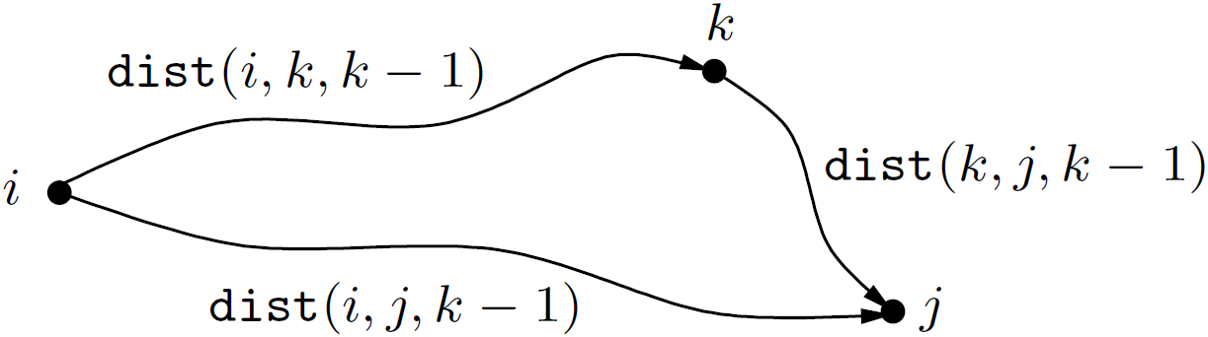
All-pairs shortest paths
All-pairs shortest paths:
(1) execute Bellman-Ford's algorithm n times.
(2) dynamic programming-based Floyd-Warshall algorithm
Idea: gradually expand the set of permissible intermediate nodes.
dist(i, j, k) = length of the shortest path from i to j in which only nodes
{1, 2, …, k} can be used as intermediates.
Using k gets a shorter path iff dist(i, k, k-1)+dist(k, j, k-1)<dist(i, j, k-1).
for i = 1 to n
for j = 1 to n
dist(i, j, 0) =
for all (i, j) E
dist(i, j, 0) = l(i, j)
for k = 1 to n
for i = 1 to n
for j = 1 to n
dist(i, j, k) = min{dist(i, k, k-1)+dist(k, j, k-1), dist(i, j, k-1)}

Slide 17
On time and memory
The time complexity of a DP algorithm is easy to discern from the dag of subproblems: in many cases it is just the total number of edges in the dag! We visit the nodes in linearized order, examine each node's inedges, and, most often, do a constant amount of work per edge. By the end, each edge of the dag has been examined once.
Space complexity? It is often too wasteful to store the entire subproblem dag. The value of a particular subproblem only needs to be remembered until the larger subproblems depending on it have been solved.
Example. In the Floyd-Warshall algorithm, dist(i, j, k) is not needed once dist(·, ·, k+1) have been computed. So we only need two nn arrays to store the dist values, one for odd values of k and one for even values.
An DP algorithm often does a crucial bookkeeping to record a path in the dag.

Slide 18
The traveling salesman problem
TSP: Find a shortest Hamiltonian cycle. (n-1)!/2
Subproblem: For a subset that includes 1, and , let C(S, j) be the length of a shortest path visiting each node in S exactly once, starting at 1 and ending at j. What should we pick as the second-to-last city?
Complexity: There are at most 2^{n}·n subproblems, and each one takes O(n) time to solve. The total running time is therefore O(n²2^{n}).
C({1}, 1) = 0
for s = 2 to n //s=|S|
for all subsets of size s and containing 1
C(S, 1) =
for all
C(S, j) = min{C(S-{j}, i)+d_{ij}: }
return min_{j}C([n], j)+d_{j1}

Slide 19
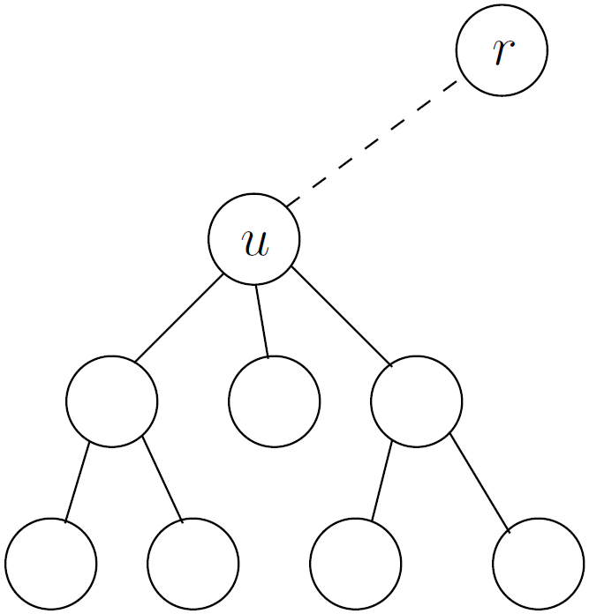
Independent sets in trees
Independent set: A node subset , no edges between them.
Finding the largest independent set in a graph is believed to be intractable. When the graph is a tree, the problem can be solved in linear time.
Subproblem:
I(u) = size of largest independent set of subtree hanging from u.

